Slide 1
Cognition Fundamentals: Kick-off
What is Cognition and how did it develop as a field?
Responsible Lecturer: Bram Heijligers

Slide 2
In the beginning...

Slide 3
Today’s Schedule

Slide 4
Break
Be back in 15 minutes!

Slide 5
Cognition Fundamentals: Perception
How do we learn from our perceptions?
Responsible Lecturer: Bram Heijligers

Slide 6
Perception
What is it? How does it related to attention, memory and robotics?

Slide 7
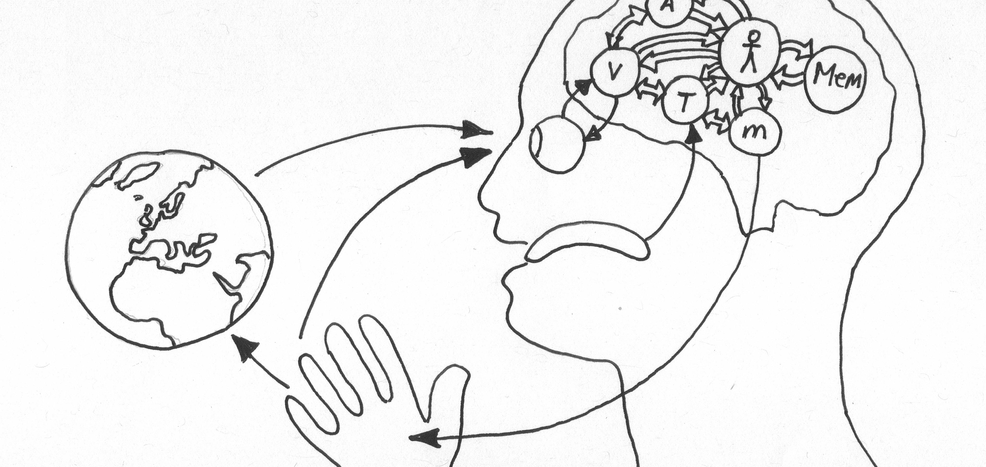
Extended Mind Theory
Objects in the external environment can be part of a cognitive process and in that way function as extensions of the mind itself.
Notes:
What does extended mind theory state? Or what is an extended mind?
[click to add definition]
Can you name some examples of mind extensions?
What is the difference between the mind and the consciousness/brain?
What is the value of Extended Mind Theory for Human Computer interaction?
What are the implications Extended Mind Theory for Human-centered Artificial Intelligence?

Slide 8
Network-Enabled Cognition Theory
The technological and informational elements of a large-scale information network can, under certain circumstances, constitute part of the material supervenience base for(/relationship between) an agent’s mental states and processes.
Notes:
What does Network-Enabled Cognition theory state?
[click to add definition]
Cognitive capacity; working memory is very limited (consicous 100 bits, unconsicious 100k bits) ; AI is only limited by the computation capacity available so it can be a great enrichment to our own intrensic cognitive capacity
Can you name some examples of network-enabled cognition?
What is the difference between the Extended Mind Theory and the network-enabled cognition?
What is the value of Network-Enabled Cognition for Human Computer interaction?
What are the implications of Network-Enabled Cognition for Human-centered Artificial Intelligence?

Slide 9

Interaction
Communication or direct involvement with someone or something: a reciprocal action or influence
Notes:
What is interaction?
[click to add definition]
Why is interaction central to the mind?
Why is interaction fundamental to data exchanges?

Slide 10
Human-Centered Artificial Intelligence
Design discipline within artificial intelligence for designing applications that are reliable, safe, and trustworthy, and effectively serve people's needs.
Notes:
Machine learning (ML) is the science of helping computers discover patterns and relationships in data instead of being manually programmed. Machine or deep learining is a powerful tool for creating personalized and dynamic experiences, and it’s already driving everything from Netflix recommendations to autonomous cars. But as more and more experiences are built with ML, it’s clear that UX designers still have a lot to learn about how to make users feel in control of the technology, and not the other way round.
What is HCAI?
[Click to add definition]
How is HCAI distinct from human-computer interaction?
Essential, products which we perceive as intelligent come with certain assumptions: specifically that the user can anticipate what the product is going to do and that the product anticipates what the user want. In other words, users expect them to respond as quasi-human.

Slide 11
Break
Be back in 15 minutes for the tutorial!

